Slide 1
Sallary gap predictionProject Demo
Dor bank, Shiran mazor
Eylon saadon

Slide 2
Business Goal
With economical and cultural advances world wide, we see that the wage and class differences between genders, are still substantial. In this project we will try to predict the wage difference, focusing on the OECD countries. Our product will be a prediction for each state in the OECD for years to come.
Main Focuse– the value we want to predict is defined as the difference between median earnings of men and women relative to median earnings of men. (base on the existing data from the OECD).
Data refer to full-time employees and to self-employed.

Slide 3
Dataset segements
Our preliminary data is:
World data bank – GenderStat.csv
OECD data center – Gender wage gaps (csv)
The OECD data will be used as the predicted data, and we will try to build a model relying on the data from the world data bank. At first, we will try to extract features solely from this data. Exploration for new data sets will occur after model evaluation if necessary.

Slide 4
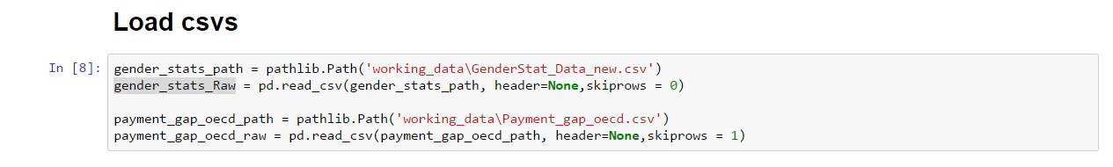
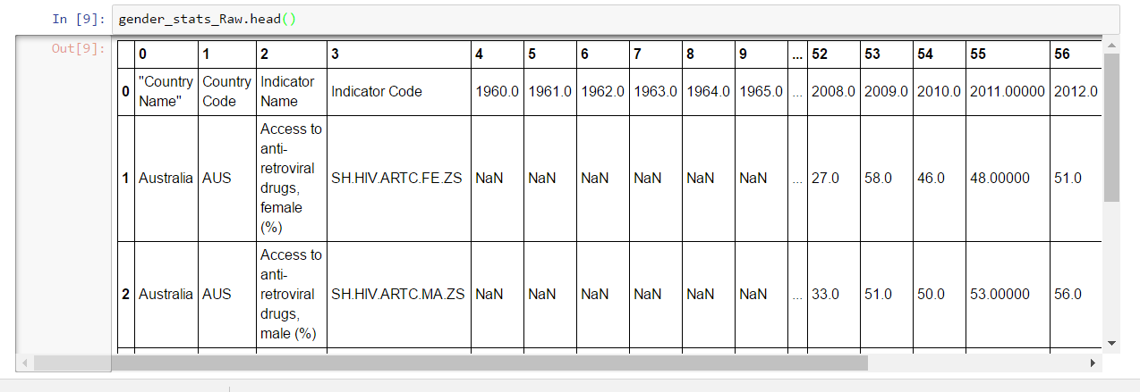
Dataset segements (2)

Slide 5
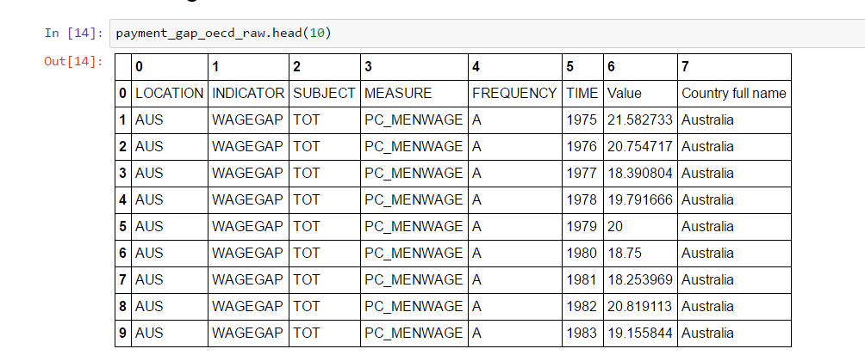
Dataset segements (2)

Slide 6
Data Preparation (overview)
Column arrangements (countries – flatten categorials, years – equal framents)
Normalizing – (Value-min(value)) / (max(value)-min(value))
Missing values:
Too many!
First removing the sparse ones without mining context (under XXX percent)
First version: median
Second version: finding similar countries with similar values

Slide 7
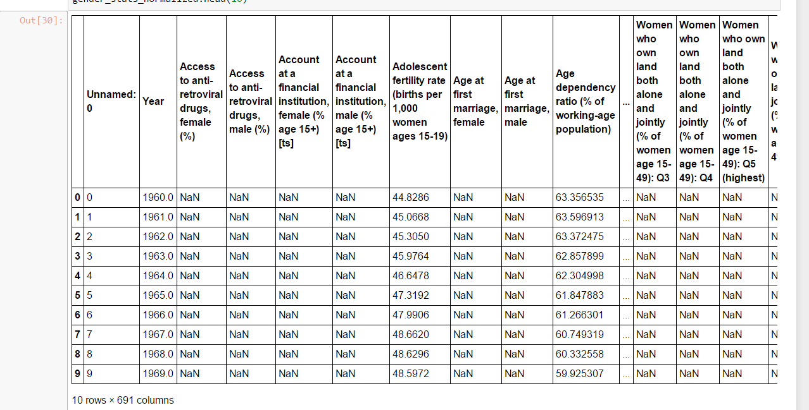
GenderStat_Data_new.csv after preliminary normalization

Slide 8
Payment_gap_oecd.csv after preliminary normalization

Slide 9
machine-learning problem Product output
Predicting average gender wage gap in the OECD
Will calculate for each state and average them deterministicly (for unbiased estimates – immediate variance reduction)

Slide 10
Problems in data
Many missing Values!
Some features are completely empty for certain countries.
Not normalized.
Features and countries in GenderStat.csv as rows and years as columns.

Slide 11
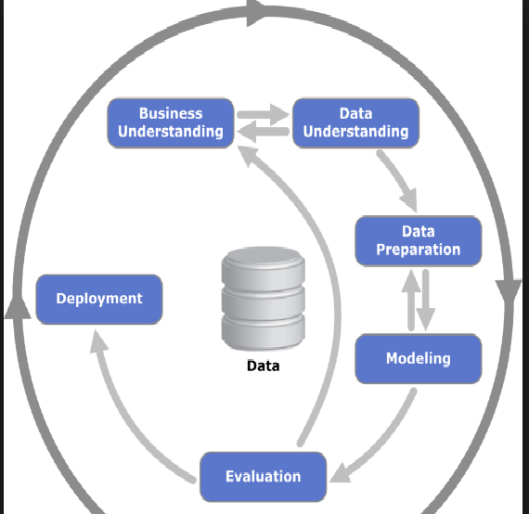
Implementation plan
Business understanding, Data understanding – done
Data preperation – as stated
Modeling and Evaluating
Step 1: simple linear regression. T-test based feature Removing (manually)?
Step 2: L1 regularization for feature selction(lambda by cross validation)
Step 3: data maninpulation status –
considering cross terms and different missing values system
Step 4: considering usage of Random Forest or SVM

